Slide 1








Fixed Income Essentials
An overview of debt securities, core features, and fundamental valuation mechanics.
Face Value (Par)
Coupon Rate
Maturity Date
Issuer Entity
The principal amount repaid to the bondholder at maturity (e.g., $1,000).
Fixed annual interest percentage paid periodically by the issuer.
The specific date when the principal investment must be fully repaid.
Governments or corporations issuing debt to raise capital.

Slide 2












Major Categories of Bonds
Government / Treasury
Corporate Bonds
Zero-Coupon Bonds
Backed by sovereign guarantees. Considered low-risk with baseline yields (e.g., US Treasuries).
Issued by businesses. Yield corresponds to credit rating (Investment Grade vs High Yield).
Issued at a discount with no periodic interest payments. Full par value repaid at maturity.
Convertible Bonds
Floating-Rate Notes
Municipal Bonds
Hybrid debt allowing investors to convert bonds into a predetermined number of equity shares.
Interest rates adjust periodically based on benchmark market indices (e.g., SOFR or EURIBOR).
Issued by local governments or states for infrastructure projects, often tax-exempt.

Slide 3











Forms of Coupon Structure
Fixed-Rate
Floating-Rate
Zero-Coupon
Constant interest rate paid throughout life of bond.
Resets periodically with reference benchmark (e.g., SOFR).
No periodic payouts; sold at deep discount to par value.
Step-Up
Inflation-Linked
Deferred / PIK
Coupon rate increases on predetermined future dates.
Coupon or principal adjusts directly with inflation index.
Interest accrues or pays in extra bonds instead of cash.

Slide 4
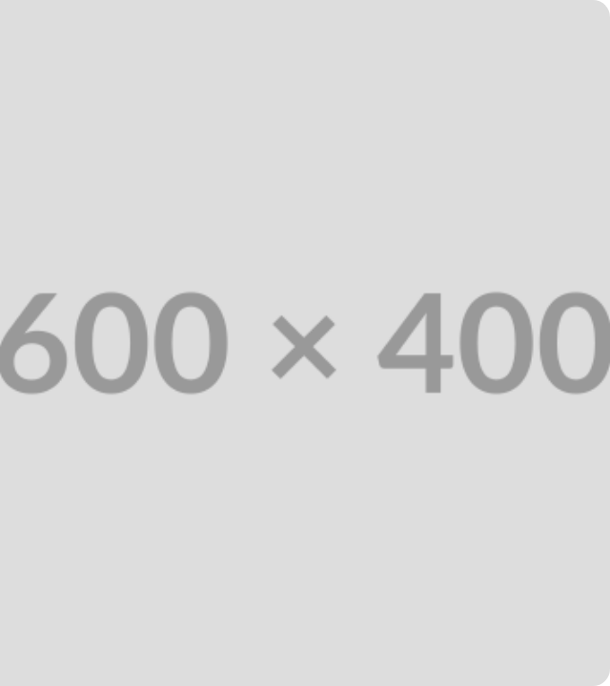
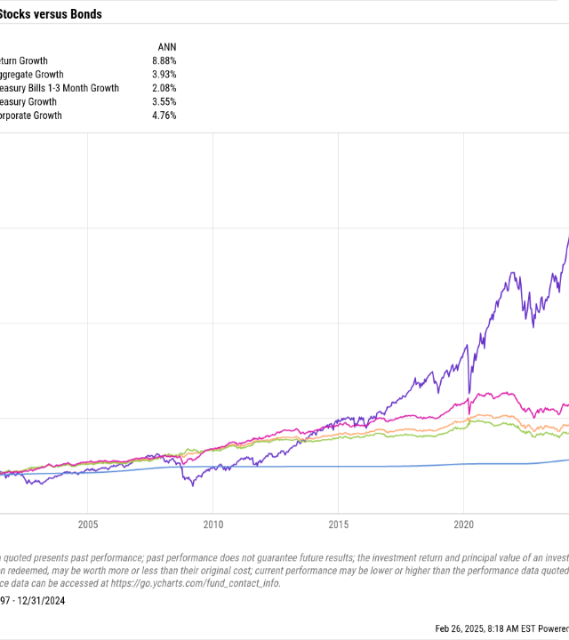



Yield to Maturity Assumptions
Yield to Maturity (YTM) represents the total expected annualized return if the bond is held until its term expires.
Held Until Maturity
The investor holds the bond security continuously until the final maturity date without early sale.
Zero Default Risk
All scheduled coupon payments and principal repayment are made in full on exact scheduled dates.
Constant Reinvestment Rate
All periodic coupon income is immediately reinvested at an interest rate equal to the YTM itself.

Slide 5






Coupon vs Yield Relationship
Trading at Discount
Trading at Par
Trading at Premium
Price < Par Value
Price = Par Value
Price > Par Value
Required market yield exceeds coupon rate. Price falls below face value to offer higher return.
Bond coupon equals prevailing market interest rate. Price matches exact face value ($1,000).
Coupon rate exceeds prevailing market rates. Investors pay a premium above face value.
INVERSE RELATIONSHIP
Market Yield Increases
Bond Price & Market Yield move in opposite directions
Bond Price Decreases

Slide 6





Bond Pricing Formula & YTM
Calculation Example
Present Value & Yield Formulas
Par Value (F): $1,000
Annual Coupon (C): 6% = $60
Maturity (n): 5 Years
Current Market Price (P): $950
Estimated YTM Calculation: YTM ≈ [60 + (1000 - 950)/5] / [(1000 + 950)/2] YTM ≈ [60 + 10] / 975 = 7.18%

Slide 7
Questions & Discussion
Fixed Income Securities | Bond Valuation & Yield Analysis
shedgevaishnavi7@gmail.com
www.itvedant.com

